Slide 1
Java arrays and strings
Lecture # 4

Slide 2
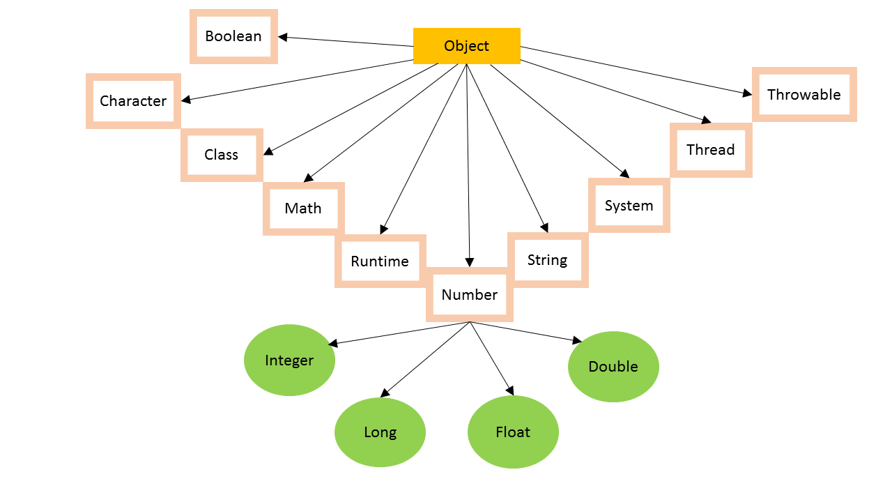
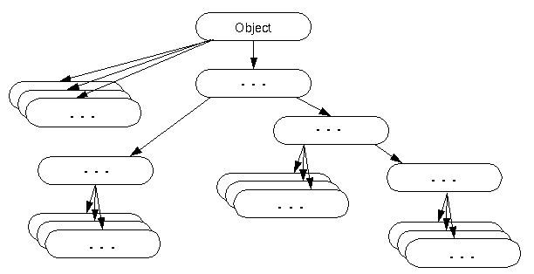
Question of the day
Which package(s) is/are imported by default in every Java Prpgram??
The default package (which is also known as the no-name package as it doesn't have the name) and java.lang packages are by default imported in the java class by the JVM.
They contain classes that are fundamental to the design of the Java language. These classes provide basic functions to the java program.
Topmost class in Java??

Slide 3
Arrays in java
Java array is an object which contains a collection of elements of similar data type.
For example, an int array contains integer elements and a String array contains String elements.
The elements of Array are stored in contiguous locations in the memory.
The size of the array is fixed, which cannot be increased later.
Array in Java is index-based. In the array, number[0] represents the first element of the array, number[1] represents the second element of the array and so on. The index of array starts from 0 and ends at array_size-1.
Since array works on a index based system, it is easier to search an element in the array, thus it gives better performance for various operations.
We can store primitive values or objects in an array in Java.
Array can be multidimensional such as 2D, 3D array etc.
Disadvantages of Array:
Fixed Size, It doesn't grow its size at runtime.
Arrays are homogeneous, they don’t allow different type values

Slide 4
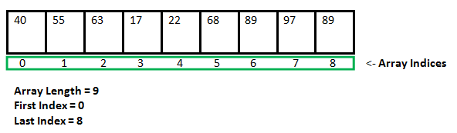
Array
Element at index 4 is ?

Slide 5
Declaration, Instantiation and Initialization of Array in Java
int number[]; //array declaration
number[] = new int[10]; //array instantiation
number[0] = 10; //array Initialization
number[1] = 20; //array Initialization
int number[] = new int[10]; // array declaration and instantiation
int a[]={33,3,4,5}; //declaration, instantiation and initialization
Valid Syntax:
int[] number;
int []number;
int number[];
Refer Example…on board

Slide 6
data types of array
byte[] anArrayOfBytes;
short[] anArrayOfShorts;
long[] anArrayOfLongs;
float[] anArrayOfFloats;
double[] anArrayOfDoubles;
boolean[] anArrayOfBooleans;
char[] anArrayOfChars;
String[] anArrayOfStrings;

Slide 7
For each loop
Example:
String[] names = {“Hamza", “Osama", “Ayesha", “Amna"};
for (String i : names) {
System.out.println(i);
}
_______________________________________________________________________________
int[] age = {12, 4, 5};
for(int a : age) {
System.out.println(a);
}
________________________________________________________________________________
IMPORTANT NOTE! you can use the built-in length property to determine the size of any array.

Slide 8
Exception
ArrayIndexOutOfBoundsException
It occurs when we access an array with an invalid index.
This happens when the index is either negative or greater than or equal to the size of the array.

Slide 9
Multidimensional array
2D array declaration:
int[][] arr;
int [][]arr;
int arr[][];
int []arr[];
Instantiate 2D Array in Java:
int[][] arr=new int[2][3]; //2 rows and 3 columns
Initialize 2D Array in Java:
arr[0][0]=11;
arr[0][1]=22;
arr[0][2]=33;
arr[1][0]=44;
arr[1][1]=55;
arr[1][2]=66;

Slide 10
Output???
int[][] myNumbers = { {1, 2, 3, 4}, {5, 6, 7} }; System.out.println(myNumbers[1][2]);

Slide 11
Jagged Array in Java
In the Java programming language, a multidimensional array is an array whose components are themselves arrays.
A consequence of this is that the rows are allowed to vary in length
If we are creating odd number of columns in a 2D array, it is known as a jagged array. In other words, it is an array of arrays with different number of columns.
int arr[][] = new int[3][];
arr[0] = new int[3];
arr[1] = new int[4];
arr[2] = new int[2];
____________________________________
String[][] names = { {"Mr. ", "Mrs. ", "Ms. "}, {"Smith", "Jones"} };

Slide 12
HW
Q: Program to print the largest element of a given array.
Q: Write a program to take size of an array from user input, take array elements from user input, sort the array in ascending order, finally print the elements of sorted array.
Q: Add two 2D matrices using arrays.
Q: Check whether two matrices are equal.
Q: Write a Java Program to Calculate average (of floating point nums)using Array
Q: Sorting char array in Java.
Q: Java Program to print the duplicate elements of an array
Q: Program to print duplicate elements of the String array

Slide 13
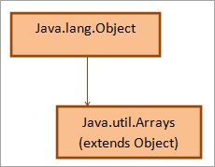
Arrays class in java
The Arrays class in java.util package is a part of the Java Collection Framework.
It consists of only static methods and the methods of Object class.
The methods of this class can be used by the class name itself.
The class hierarchy is as follows:
public class Arrays extends Object {
-
-
-
}

Slide 14
java arrays class
loops are used to do some tasks on an array like:
Fill an array with a particular value.
Sort an Arrays.
Search in an Arrays.
And many more.
Arrays class provides several static methods that can be used to perform these tasks directly without the use of loops, hence forth making our code super short and optimized.
Some commonly used methods are;
sort(), binarySearch(), compare(array 1, array 2), copyOf(originalArray, newLength), equals(array1, array2), fill(originalArray, value)

Slide 15
Copying Arrays
Multiple ways to do the task
Manual copying using for loop
Using java.lang.System.arraycopy()
Using java.util.Arrays.copyOf()
Using java.util.Arrays.copyOfRange()
Using Object.clone()

Slide 16
Copying Arrays
The java.lang.System.arraycopy() method copies an array from the specified source array, beginning at the specified position, to the specified position of the destination array.
public static void arraycopy(Object src, int srcPos, Object dest, int destPos, int length)
Parameters
src − This is the source array.
srcPos − This is the starting position in the source array.
dest − This is the destination array.
destPos − This is the starting position in the destination data.
length − This is the number of array elements to be copied.
Return Value
This method does not return any value.
Exception
IndexOutOfBoundsException − if copying would cause access of data outside array bounds.
ArrayStoreException − if an element in the src array could not be stored into the dest array because of a type mismatch.
NullPointerException − if either src or dest is null.

Slide 17
Copying Arrays
Example:
class ArrayCopyDemo {
public static void main(String[] args) {
String[] copyFrom = { “Pepsi", “Pakola", “Slice", “Sting", “Sprite", “7Up", “CocaCola", “Fanta", “Mrinda", “AppleCidra"};
String[] copyTo = new String[7];
System.arraycopy(copyFrom, 2, copyTo, 0, 6);
for (String drink : copyTo) {
System.out.print(drink + " ");
}
}
}

Slide 18
Copying Arrays
copyOfRange() method of the java.util.Arrays class
class ArrayCopyOfDemo {
public static void main(String[] args) {
String[] copyFrom = { “Pepsi", “Pakola", “Slice", “Sting", “Sprite", “7Up", “CocaCola", “Fanta", “Mrinda", “AppleCidra"};
String[] copyTo = java.util.Arrays.copyOfRange(copyFrom, 2, 6);
for (String drink : copyTo) {
System.out.print(drink + " ");
}
}
}

Slide 19
Strings in java
Strings, which are widely used in Java programming, are objects which represent a sequence of characters.
There are two ways to create a String in Java
String literal String st1=“This is string";
Using new keyword String st2 = new String(“An other string”);

Slide 20
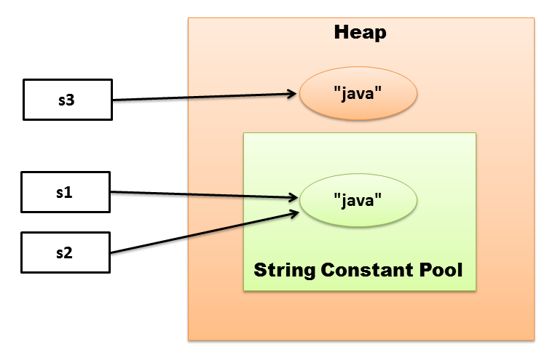
Difference in two methods
String s1 = “ java”;
String s2 = “java”;
String s3 = new String(“java”);
In example Compare with;
==
equals()

Slide 21
Some String methods
Length()
charAt()
equals()
concat()
String toUpperCase()
Boolean isEmpty()
Char[] toCharArray()
Many more…

Slide 22
Examples
String txt = "ABCDEFGHIJKLMNOPQRSTUVWXYZ";
System.out.println("The length of the txt string is: " + txt.length());
________________________________________________________________
String txt = "Hello World";
System.out.println(txt.toUpperCase());
System.out.println(txt.toLowerCase());
___________________________________________________________________
String txt = "Please locate where 'locate' occurs!"; System.out.println(txt.indexOf("locate"));

Slide 23
String Concatenation
String firstName = “Asif Ali";
String lastName = “Zardari";
String fullName = firstName + lastName; // numbers add, string concat
System.out.println(firstName + " " + lastName);
System.out.println(fullName);
_________________________________________________________
String firstName = "John "; String lastName = "Doe"; System.out.println(firstName.concat(lastName));

Slide 24
String Array in Java
String Array Declaration:
String[] strArray; // without specifying size
String[] strArray = new String[5]; // with specifying size
________________________________________________________________________________________________
String Array Initialization:
String[] names = {“Ali", "Amna", "Hamza", “Ayesha"};
or
String[] names = new String[] {“Ali", "Amna", "Hamza", “Ayesha"}; //with new key word
_________________________________________________________________________________________________
Normal Initialization after declaration:
String[] names= new String[4];
names[0]= “Sarah"; //first element
names[1]= “Osama"; //second element

